Slide 1

Multibrowser Testing using Selenium

Slide 2
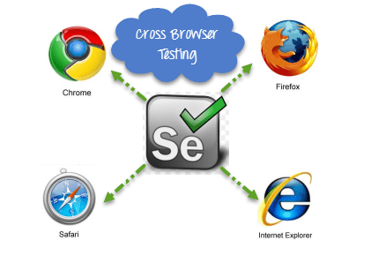
Introduction
Multi browser testing or cross browser testing is a type of testing in which the application under test is tested with multiple supported browsers.

Slide 3
Need of Multi Browser Testing
Multi Browser Testing reasons are:-
Font size mismatch in different browsers.
JavaScript implementation can be different.
CSS,HTML validation difference can be there.
Some browser will not supporting HTML5.
Page alignment and div size.
Image orientation.
Browser incompatibility with OS.

Slide 4
Implementation of Multi Browser Testing
Create your Script to test a LogIn application using TestNG class.
2) Pass ‘Browser Type’ as parameters using TestNG annotations to the before method of the TestNG class. This method will launch only the browser, which will be provided as parameter.
Now see the code here:-
package parallelTest;
import org.openqa.selenium.By;
import org.openqa.selenium.WebDriver;
import org.openqa.selenium.firefox.FirefoxDriver;
import org.openqa.selenium.ie.InternetExplorerDriver;
import org.testng.annotations.AfterClass;
import org.testng.annotations.BeforeClass;
import org.testng.annotations.Parameters;
import org.testng.annotations.Test;

Slide 5
public class CrossBrowserScript {
public WebDriver driver;
@Parameters("browser")
@BeforeClass
// Passing Browser parameter from TestNG xml
public void beforeTest(String browser) {
// If the browser is Firefox, then do this
if(browser.equalsIgnoreCase("firefox")) {
driver = new FirefoxDriver();
// If browser is IE, then do this
}else if (browser.equalsIgnoreCase("ie")) {
// Here I am setting up the path for my IEDriver
System.setProperty("webdriver.ie.driver", "D:\ToolsQA\OnlineStore\drivers\IEDriverServer.exe");
driver = new InternetExplorerDriver();
}

Slide 6
// Doesn't the browser type, lauch the Website
driver.get(URL);
}
// Once Before method is completed, Test method will start
@Test public void testParameterWithXML() throws InterruptedException {
driver.findElement(By.xpath(".//*[@id='account']/a")).click();
driver.findElement(By.id("log")).sendKeys(“admin");
driver.findElement(By.id("pwd")).sendKeys("Test@123456");
driver.findElement(By.id("login")).click();
}
@AfterClass public void afterTest() {
driver.quit();
}
}

Slide 7
3) Create a TestNG XML for running your test.
<?xml version="1.0" encoding="UTF-8"?>
<!DOCTYPE suite SYSTEM "http://testng.org/testng-1.0.dtd">
<suite name="Suite" parallel="tests">
<test name="FirefoxTest">
<parameter name="browser" value="firefox" />
<classes>
<class name="parallelTest.CrossBrowserScript" />
</classes>
</test>
<test name="IETest">
<parameter name="browser" value="ie" />
<classes>
<class name="parallelTest.CrossBrowserScript" />
</classes>
</test>
</suite>

Slide 8
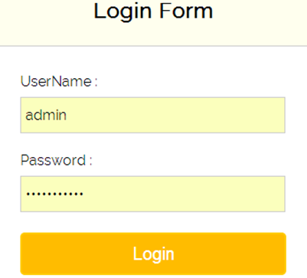
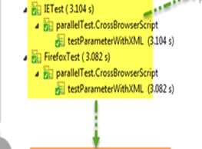
OUTPUT:-

Slide 9
Covered Till Now
Cross browser Testing is a technique to test web application with different web browsers.
Selenium can support different type of browsers for automation.
Selenium can be integrated with TestNG to perform Multi Browser Testing.

Slide 10
Thanks

